Slide 1
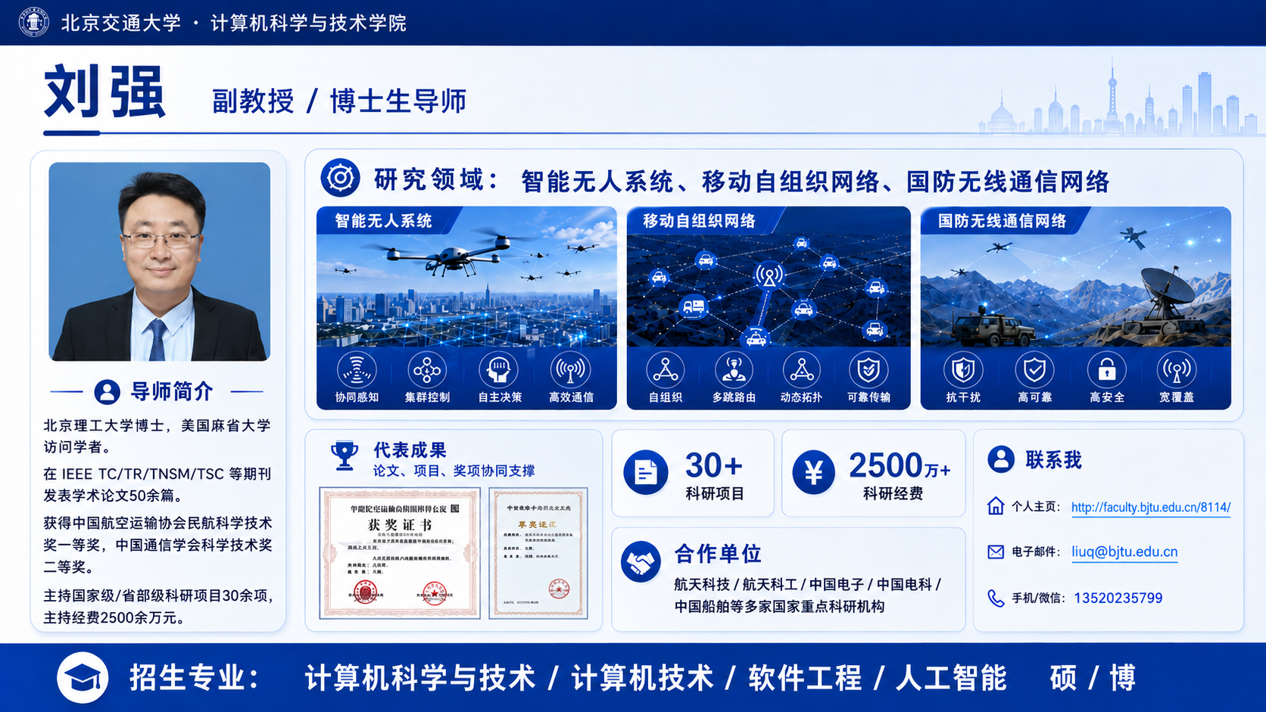
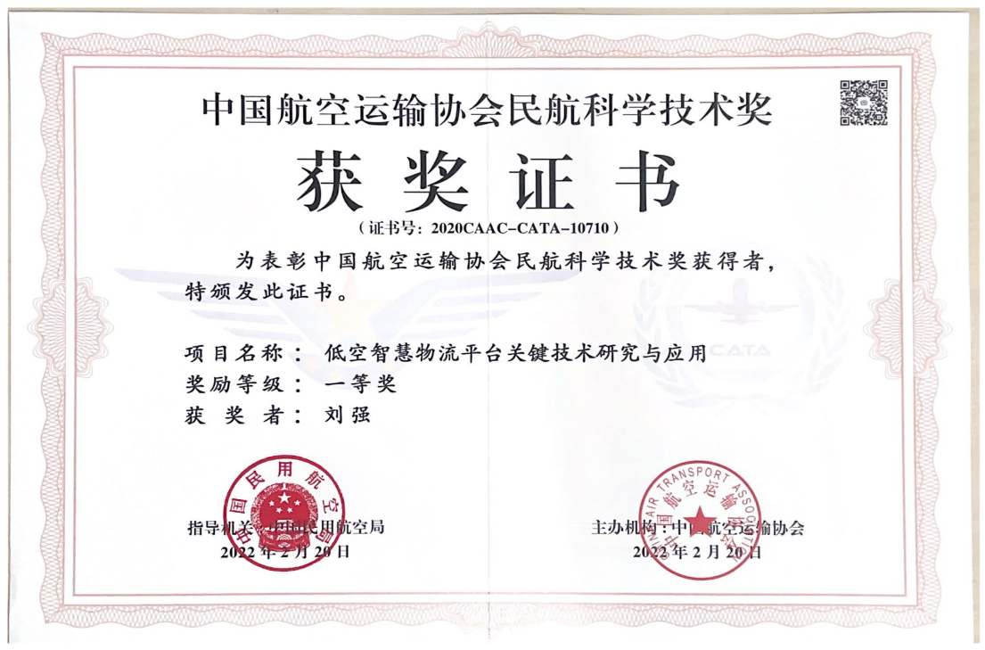
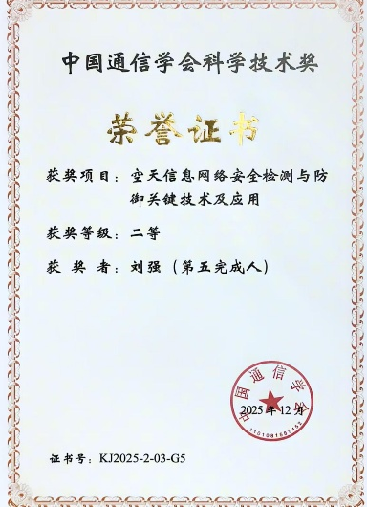
https://faculty.bjtu.edu.cn/8114
liuq@bjtu.edu.cn

Slide 2
